Slide 1
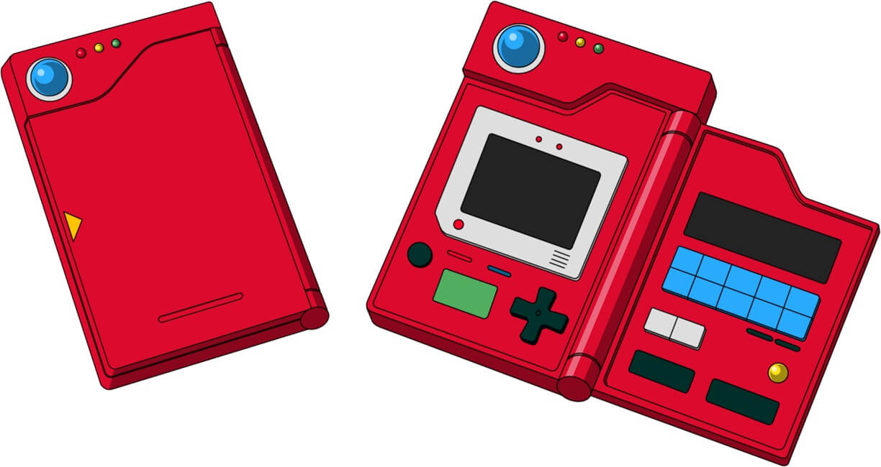




Predicting Pokemon types with stats from over 721 Pokémon

Slide 2

Background Info
Nintendo released Pokemon Red & Green for Gameboy Japan in 1996
Each Pokemon has a type and specific base stat that made it strong or weak against other Pokemon
150 Pokemon in Gen I, with 15 types
802 Pokemon in Gen VII with 18 types
Pokemon can have a primary and secondary type
For this project, we will be looking at primary type only because with the combination possibilities, there are 146 type combinations

Slide 3

Problem Statement and Hypothesis
By looking at and comparing the pokemon base stats (including HP, attack, special attack, defense, special defense, and speed) can we accurately predict the pokemon’s primary type. Some Pokemon only have 1 type, so Type_2 will show as NaN. We are going to ignore these for this project.
There are a lot of pokemon out there, and it’d be cool to predict its strengths and weaknesses by looking at base stats. I’ve been playing Pokemon since the original games came to USA in 1997, and still love it
Note- we will only be looking at the game data. This will not include the trading cards, Pokemon Go, or the animated series

Slide 4

About the Data
I found this data on Kaggle https://www.kaggle.com/abcsds/pokemon
Most of the data was sourced from data found on Bublapedia, a Pokemon encyclopedia:http://bulbapedia.bulbagarden.net/wiki/Main_Page
The data set contains information from Gen I to Gen VI, so I pulled my own testing data from Bulbapedia and used Pokemon from Gen VII as testing. I will split with Test/Train Split after

Slide 5
About the Pokemon Generations
Generation | Years | Games
Gen I | 1996-1999 | Red, Green, Blue, Yellow
Gen II | 1999-2002 | Gold, Silver, Crystal
Gen III | 2002-2006 | Ruby, Sapphire, Emerald, Remakes-FireRed, LeafGreen
Gen IV | 2006-2010 | Diamond, Pearl, Platinum Remakes- HeartGold, SoulSilver
Gen V | 2010-2013 | Black, White Remakes- Black2 White2
Gen VI | 2013-2016 | X, Y Remakes- Omega Ruby, Alpha Sapphire
Gen VII | 2016-present | Sun, Moon

Slide 6
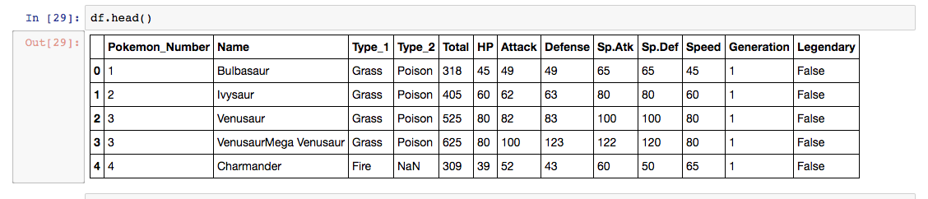
First Looks
There are 801 rows and 13 columns

Slide 7
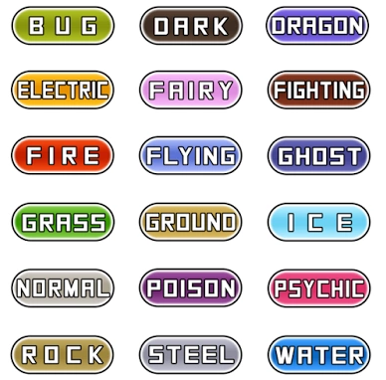
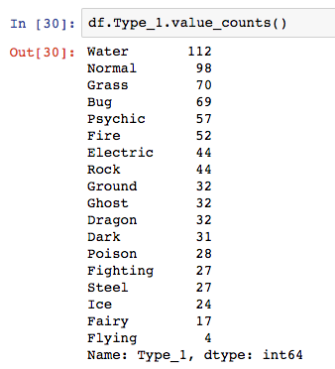
Looking at Pokemon Types

Slide 8
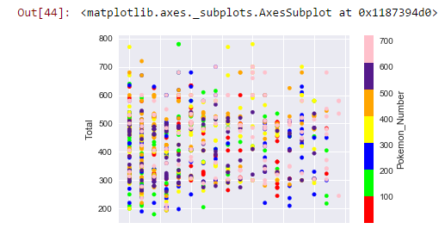
Graphing
Renaming the types with a numeric value
Scatter Plot: X = Type_1, Y = Total (all stats added together) and c = Pokemon Number
You can see the 18 columns for the different types. You can also see that there is a high range with the TOTAL metric

Slide 9
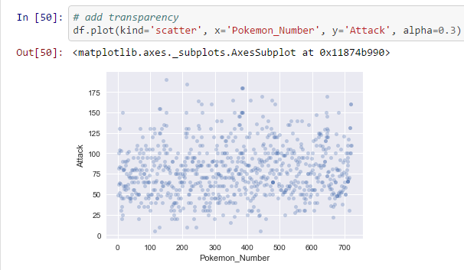
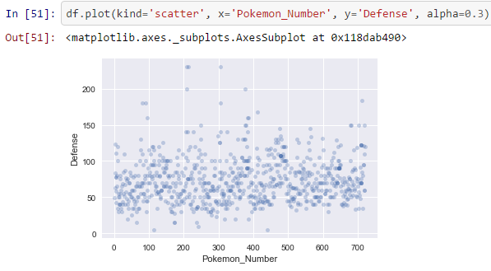
Scatter Plots of Pokemon Stats
Attack Defense

Slide 10
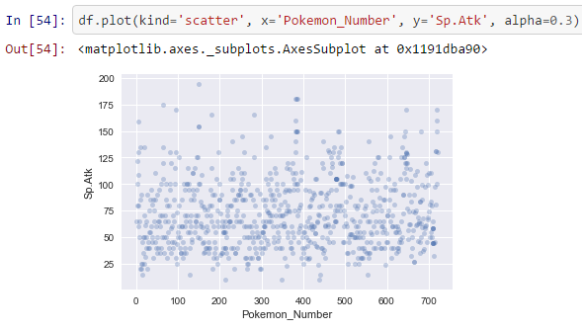
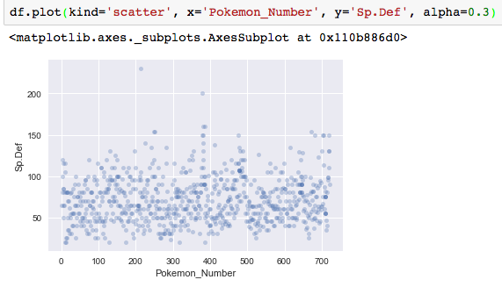
Continued
Special Attack Special Defense

Slide 11
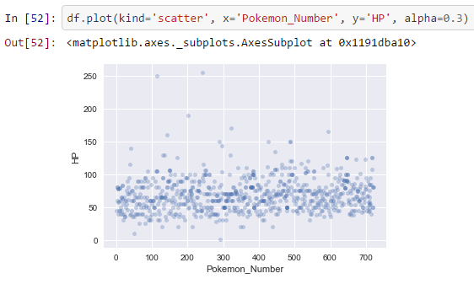
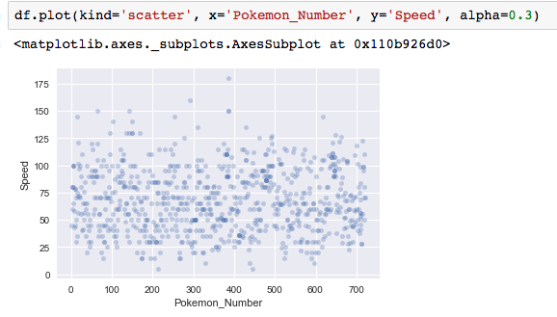
Continued
HP Speed

Slide 12
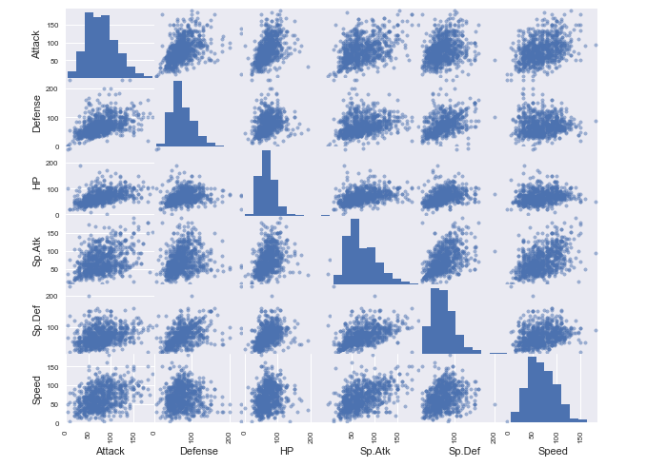
Scatter Matrix of Pokemon Stats

Slide 13
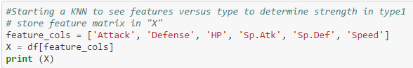
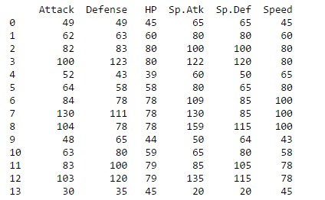
KNN to predict Type based on Stats- Step 1
Basic KNN Model, without test/train split
Creating our features (X)
Notes:
Picked features Attack', 'Defense', 'HP', 'Sp.Atk', 'Sp.Def', 'Speed']
Defined X

Slide 14
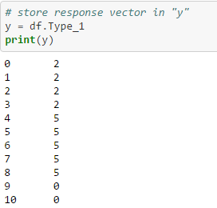
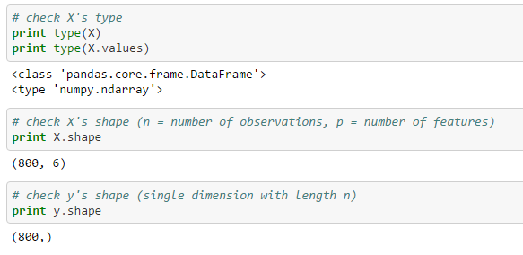
Step 1 Continued...
Creating our response vector, y and checking types

Slide 15
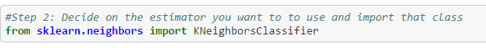

Step 2. Import the Estimator
In this step, we’re going to import KNN Classifier from Sklearn

Slide 16
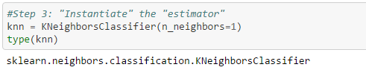
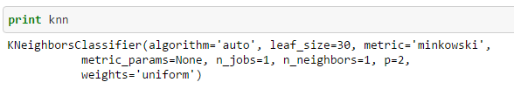
Step 3. Instantiate the estimator

Slide 17
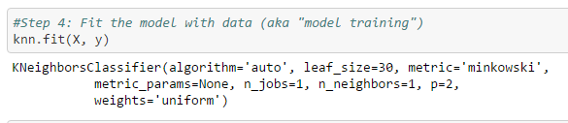
Step 4. Fit the Model
We’re using stats from Generation I through Generation VI to fit the KNN model. For our predictions, we’ll use Pokemon stats from Gen VII

Slide 18
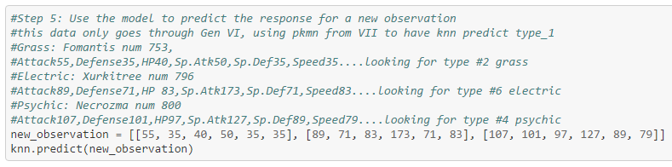
Step 5. Use the model to predict the response for a new observation
Adding a new observation to see how it is classified
Notes:
#3 is bug, not too far from grass.. #6 is on point with the prediction of electric! #5 is fire, this one is a bit more off

Slide 19
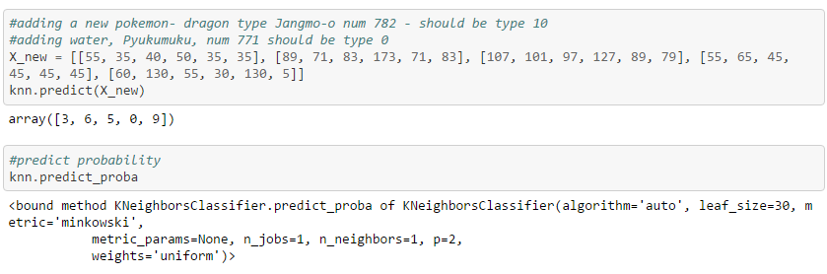
Step 5 continued...

Slide 20
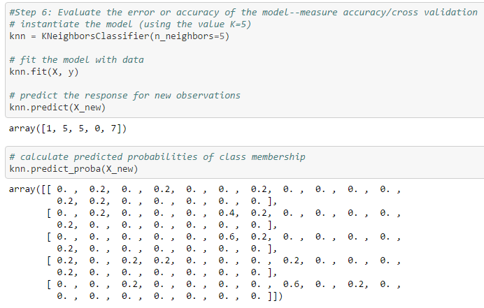
Step 6. Evaluate Accuracy

Slide 21

KNN Model pt 1 Conclusions
It predicts sometimes, but it’s not very accurate.
We can use different models to increase the accuracy or find a more precise accuracy measurement
I will start working with decisions trees, clustering, and Random Forests to see if the accuracy will improve
I will also use test/train split to see how that changes the model

Slide 22
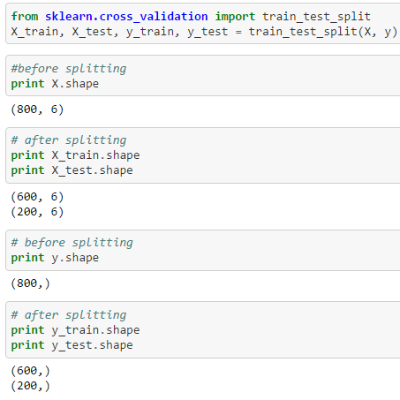
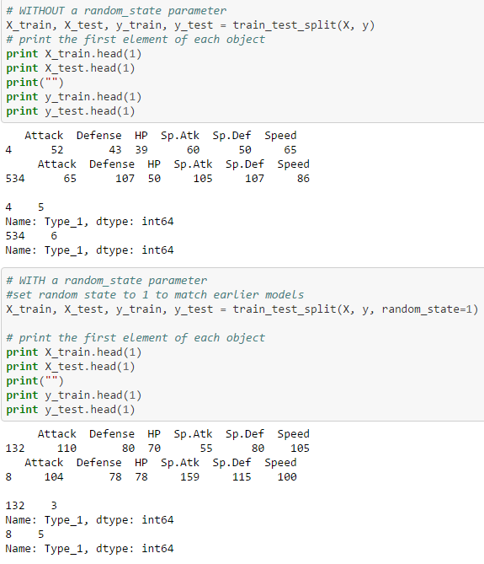
Adding Test/Train Split to KNN

Slide 23
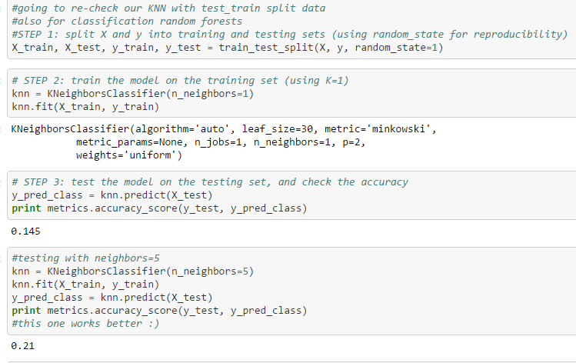
Checking our KNN post Test/Train Split

Slide 24
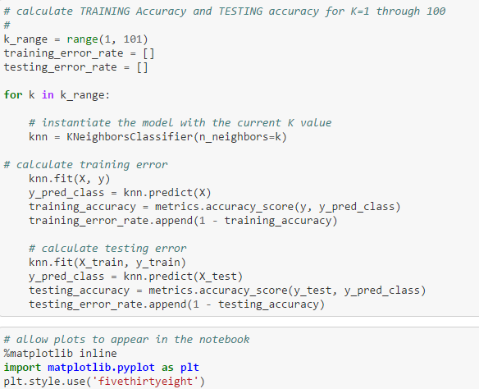
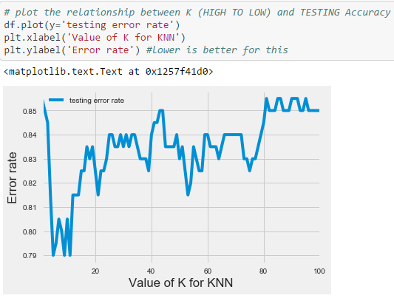
Continued…(finding error values)

Slide 25
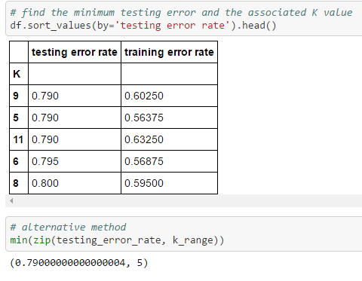
View our K Values and Error Rates
We want the lowest error rates, and we find that at K = 5
K=9 isn’t far off, but the training error is a bit higher
The zip at the bottom reassures that we want to pick K=5
We can also see that we are left with a 21 % accuracy with our testing data (our training error rate here is only .56375, so the accuracy on our training data is 43.625%

Slide 26
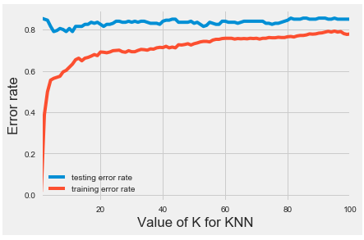
Plotting K for KNN
This model is comparing the testing data to the training data.
The testing data has higher error rates than the training data

Slide 27
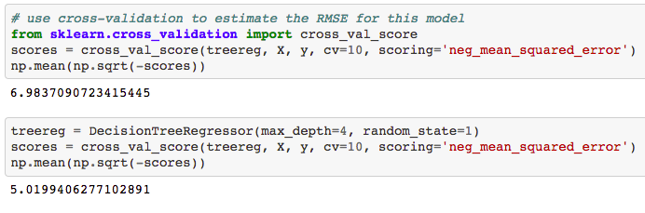
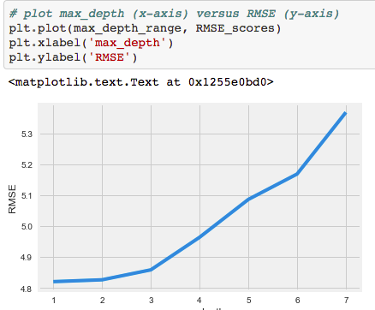
Decision Trees
Import DecisionTreeRegressor and Cross_validation from sklearn
From the graph, we can see that we’ll have the best results with 1 or 2 levels

Slide 28
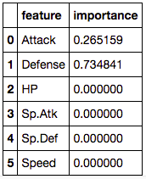
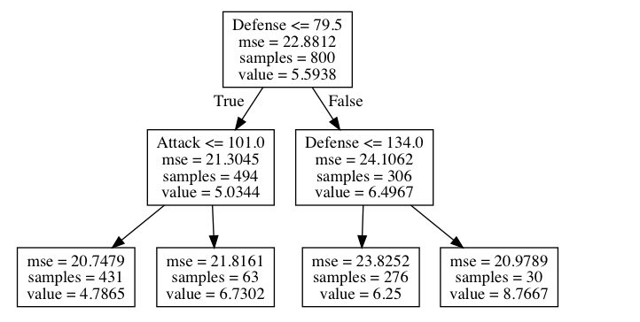
Decision Tree Results

Slide 29
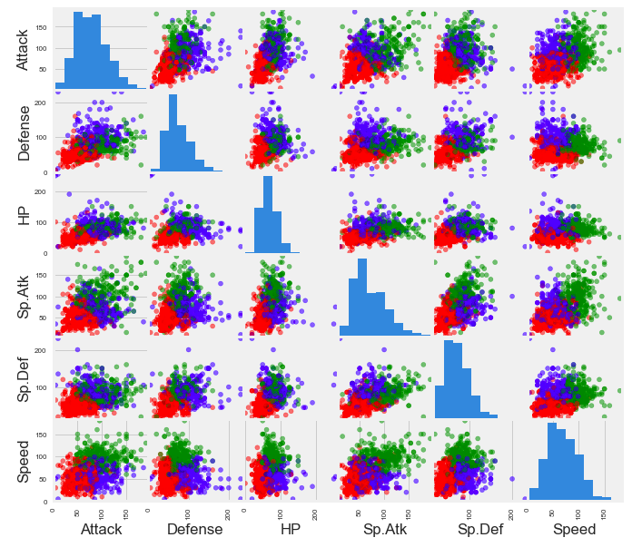
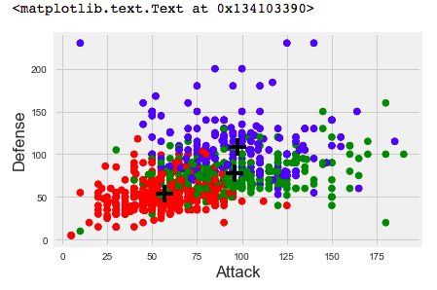
3 Clusters based on Attack and Defense
The + marks the center of the cluster

Slide 30
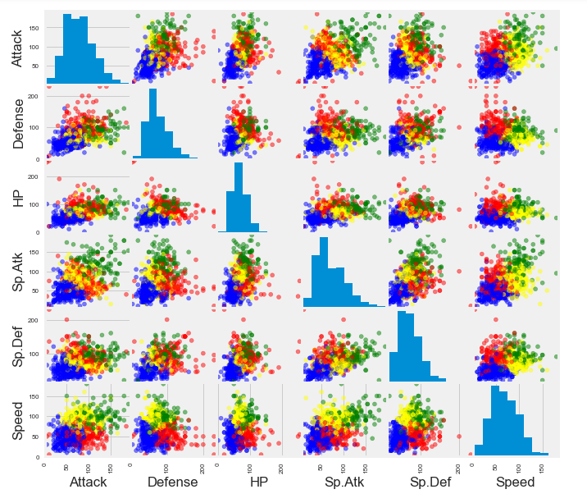
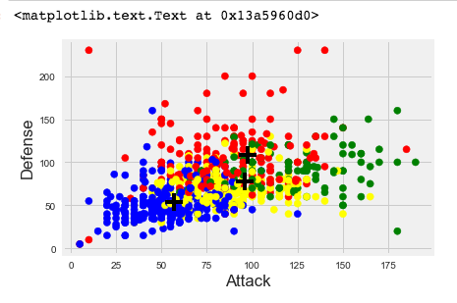

4 Clusters

Slide 31
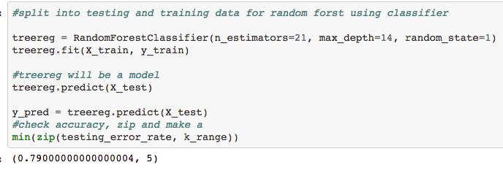
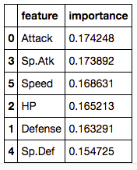
Random Forest Classifier
Random Forest gives us a more accurate feature importance than the decision trees. Using this, we can also see that we have a 79% error rate at our best K value. The best K value is 5, and we have 21% accuracy

Slide 32

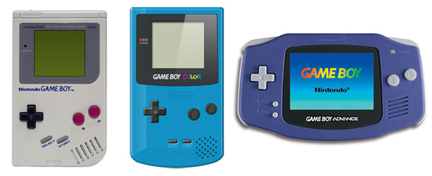
Conclusion
KNN and Random Forest Classifier gives K= 5, testing error 79%, training error 43.635%
Using the stats is not a great tool for predicting the pokemon type, but it works sometimes
Shows that for most pokemon types, we can have high or low stats, it’s not always the same (good for having more even pokemon battles!)

